Slide 1
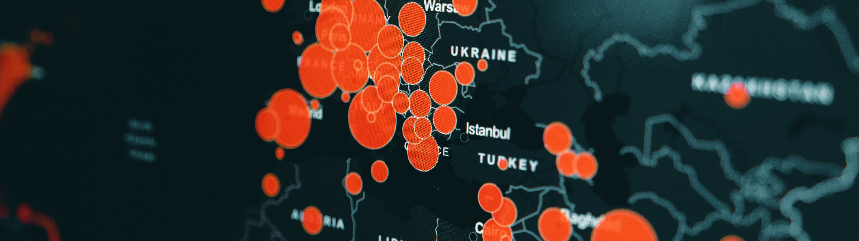
Data Analysis Report for Fond Rouge
Aditya Dey, SAP
25th December 2022

Slide 2

Data Analysis Report for Fond Rouge
Aditya Dey, SAP
Month 12, 2022

Slide 3
Agenda
OVERVIEW
ISSUES
CAUSE
SUGGESTIONS
Global Picture
Biggest Revenue contributors, Highest number of Order Returns, Refund/Revenue Ratio
Overview of Fond Rouge’s Data
An Overview of the Result obtained after Data Analysis of Fond Rouge company’s Data.
Issues Found
What are the main issues we found in the whole analysis.
Likely Cause
What are the main causes for the evolved issues
Suggestions
The suggestions that can help in for more better result at the end.

Slide 4
Global Picture
OVERVIEW
ISSUES
CAUSE
SUGGESTIONS

Slide 5
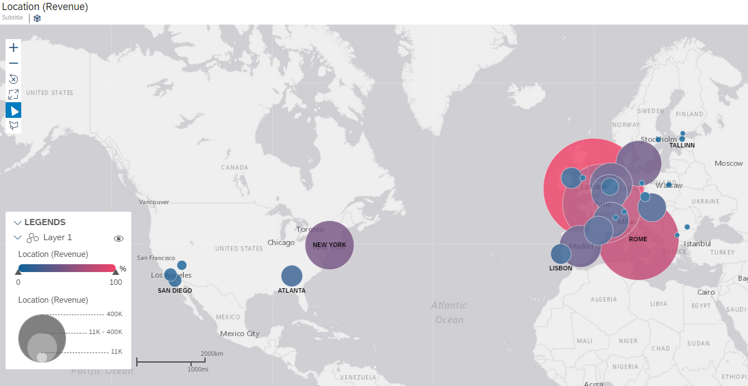
OVERVIEW
ISSUES
CAUSE
SUGGESTIONS
Biggest Revenue Contributors

Slide 6
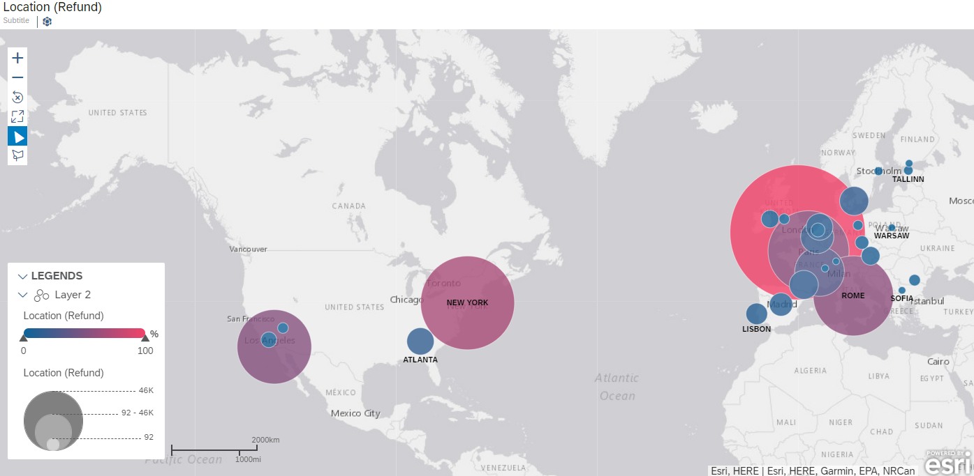
OVERVIEW
ISSUES
CAUSE
SUGGESTIONS
Highest number of Order returns

Slide 7
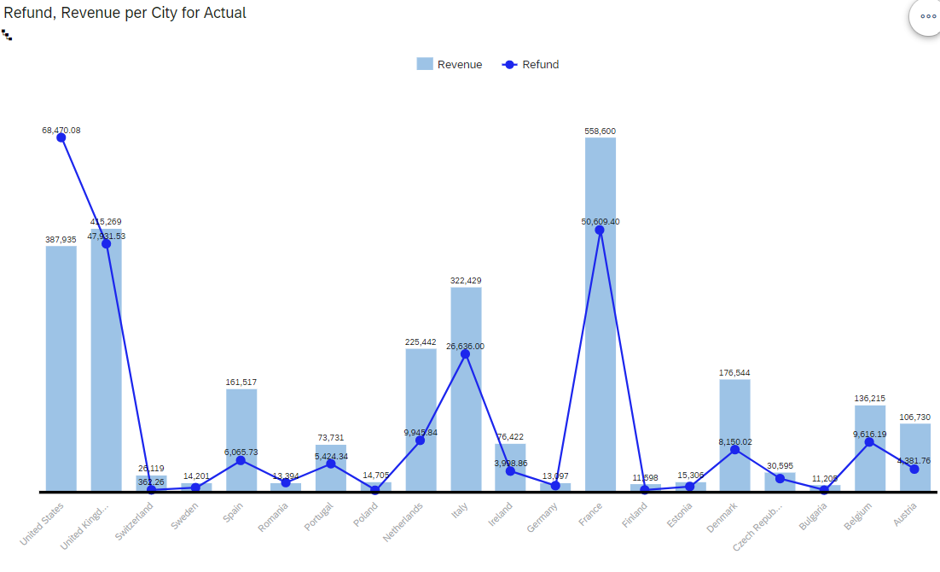
Refund VS Revenue per City

Slide 8
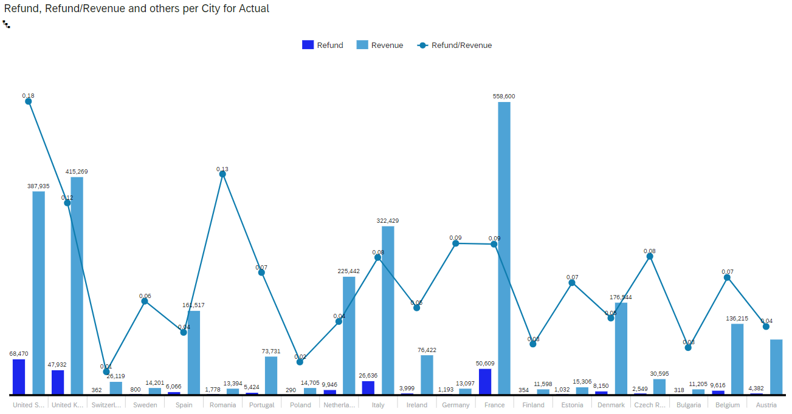
Refund/Revenue Ratio
Avg
Sentiment

Slide 9
Overview of Fond Rouge’s Data Analysis
OVERVIEW
ISSUES
CAUSE
SUGGESTIONS
Avg
Sentiment

Slide 10
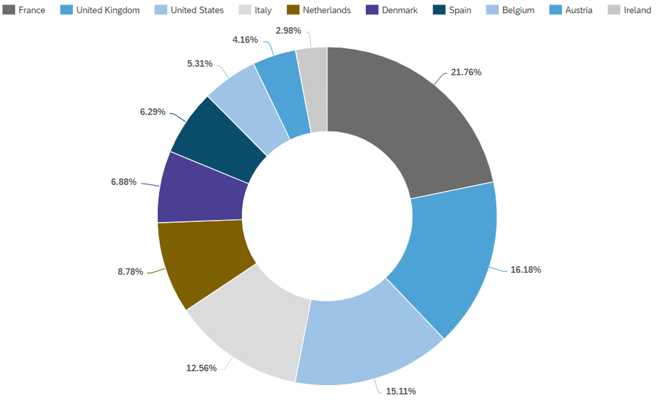
Revenue per City
OVERVIEW
ISSUES
CAUSE
SUGGESTIONS
TOP N CITIES
Avg
Sentiment

Slide 11
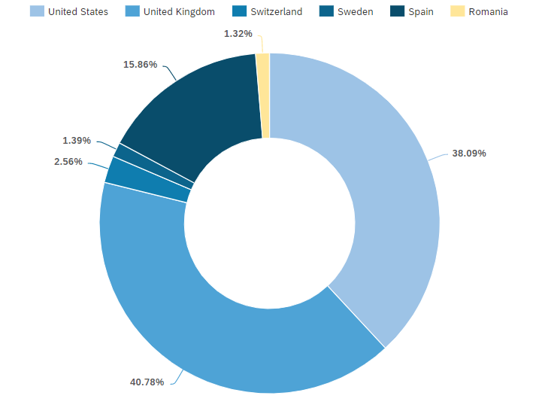
Revenue per City
OVERVIEW
ISSUES
CAUSE
SUGGESTIONS
TOP vs BOTTOM N CITIES
Avg
Sentiment

Slide 12
Issues Found in the Analysis
OVERVIEW
ISSUES
CAUSE
SUGGESTIONS
Avg
Sentiment

Slide 13
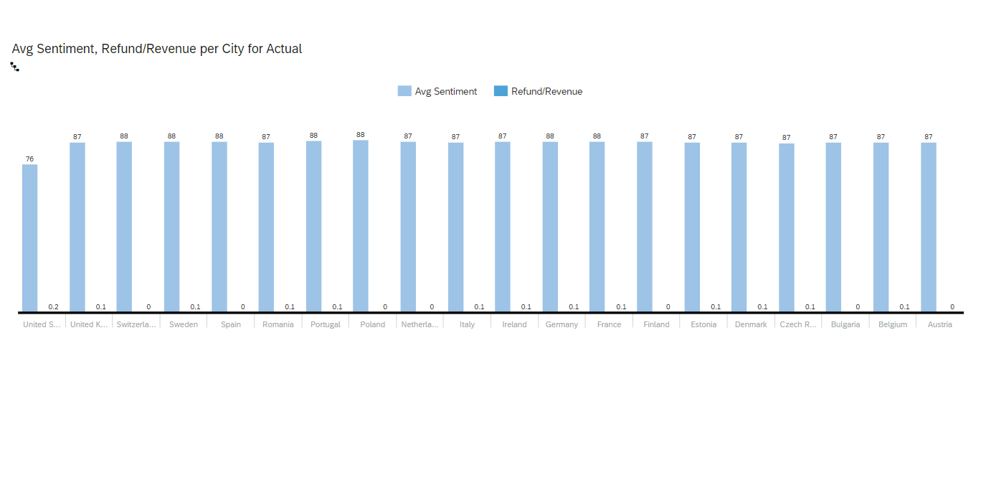
OVERVIEW
ISSUES
CAUSE
SUGGESTIONS
Using NPS + Refund/Revenue Ratio to spot the problem
We can clearly see a drastic drop in United States, in the
average sentiment score as compared to others.

Slide 14
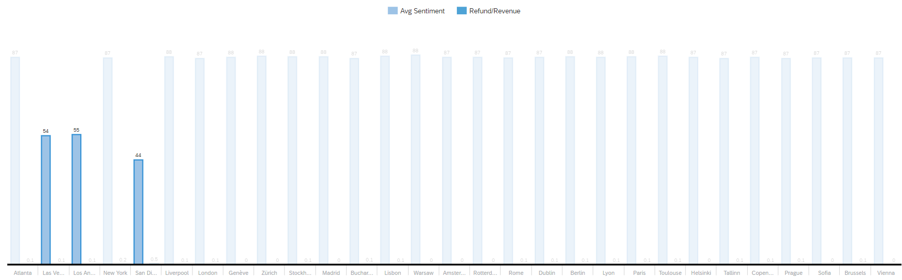
OVERVIEW
ISSUES
CAUSE
SUGGESTIONS
US
0.1
0.1
0.2

Slide 15
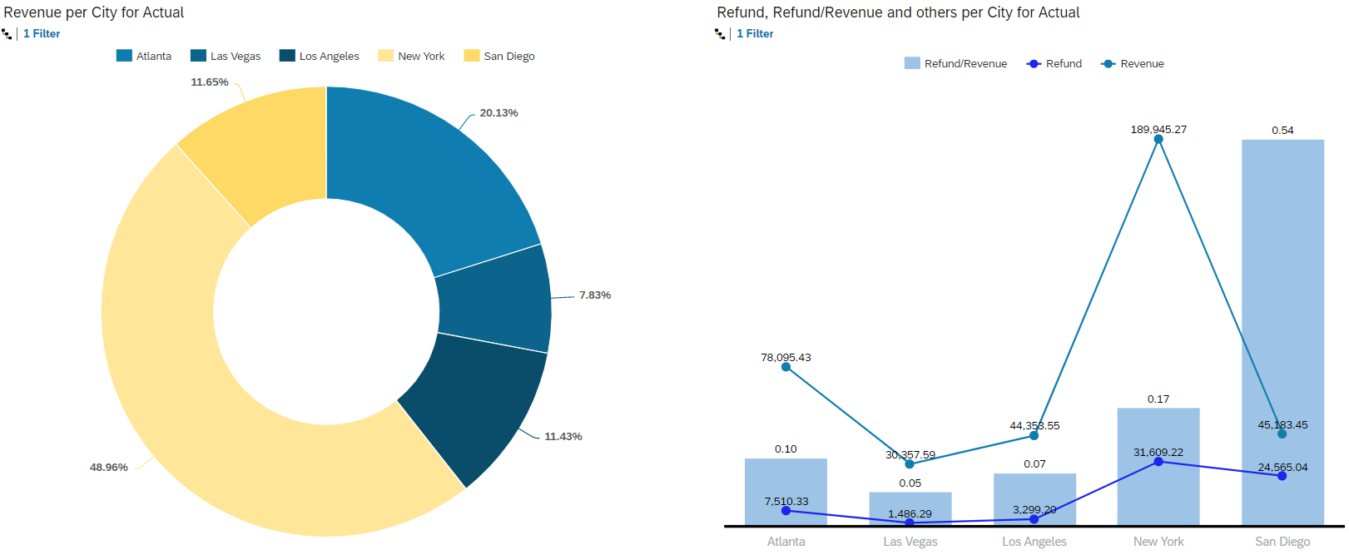
US
OVERVIEW
ISSUES
CAUSE
SUGGESTIONS
Avg
Sentiment

Slide 16
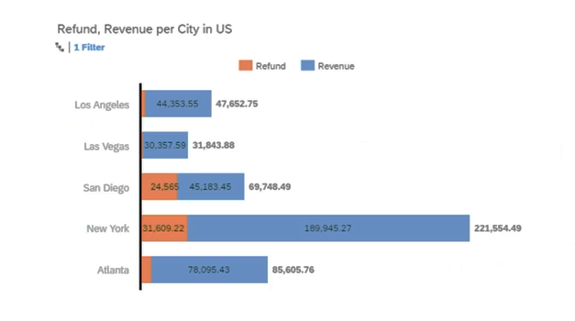
OVERVIEW
ISSUES
CAUSE
SUGGESTIONS
Potential Quality Issue in San Diego

Slide 17
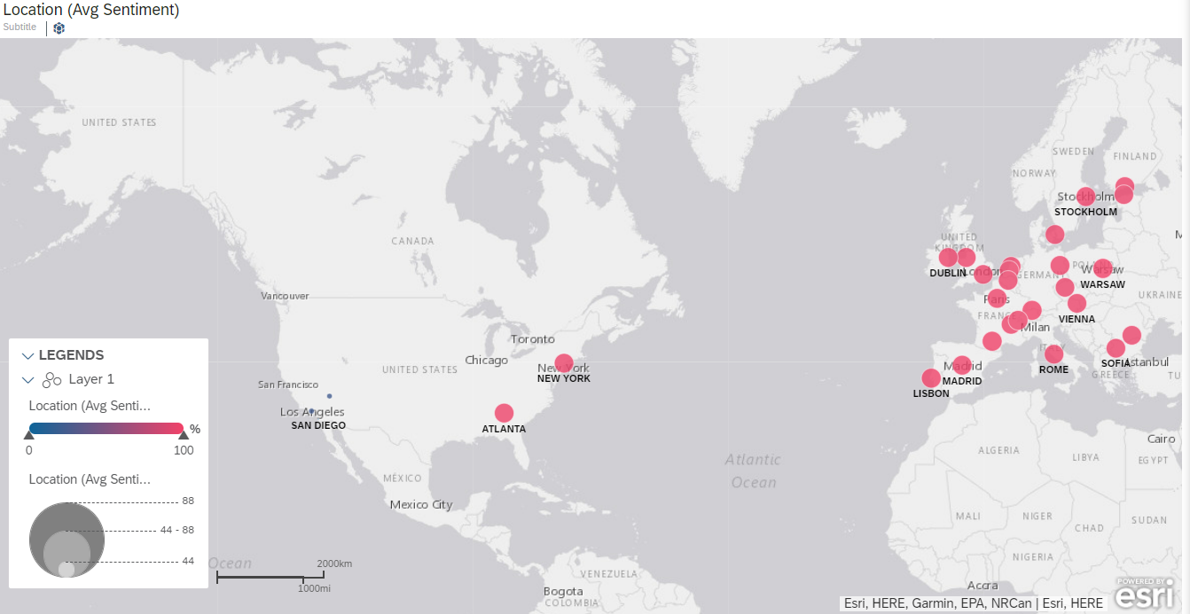
OVERVIEW
ISSUES
CAUSE
SUGGESTIONS
Average Sentiment
NPS

Slide 18
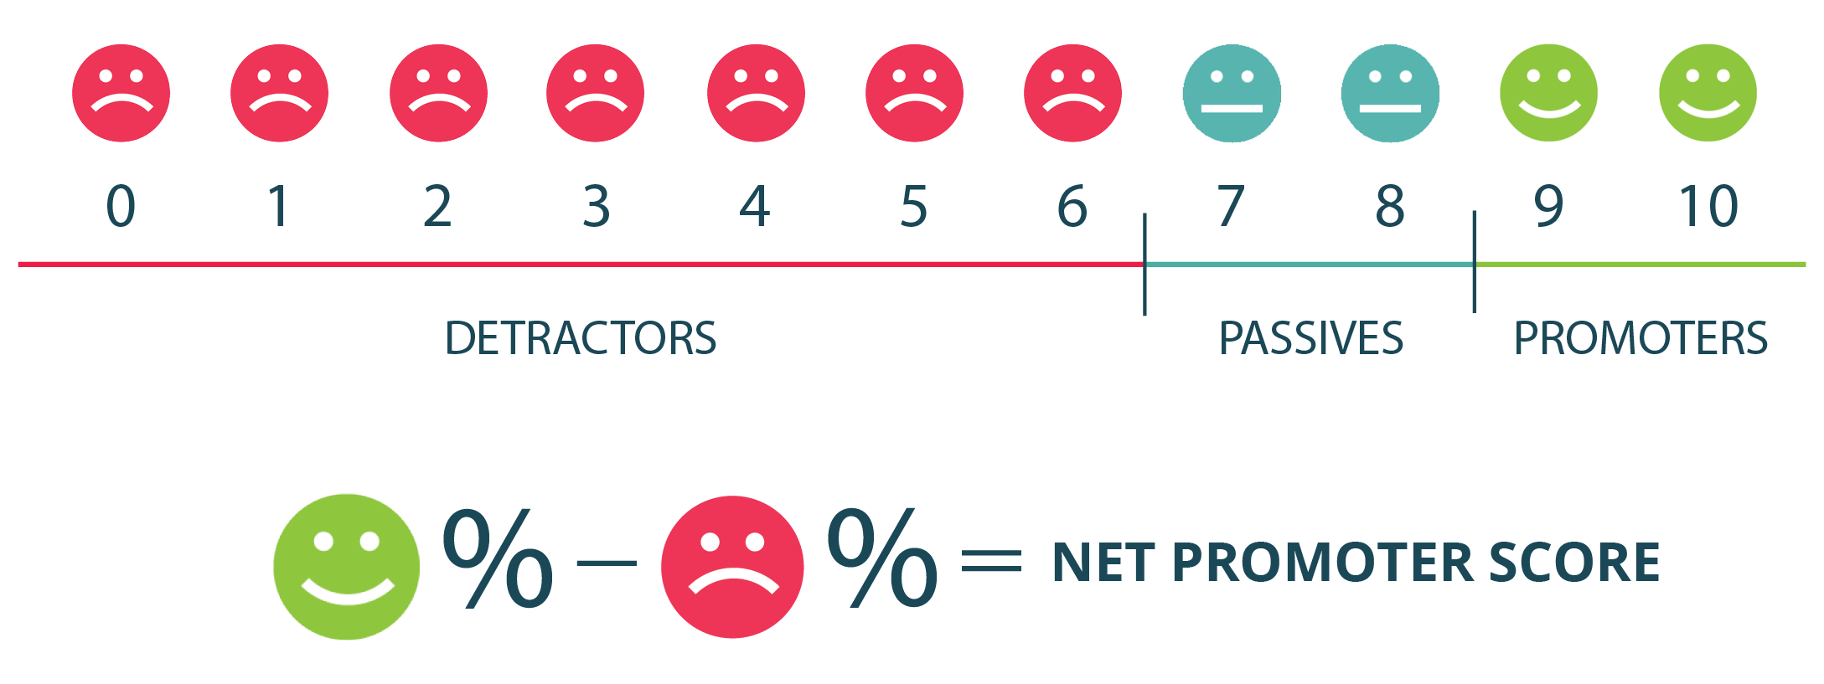

Slide 19
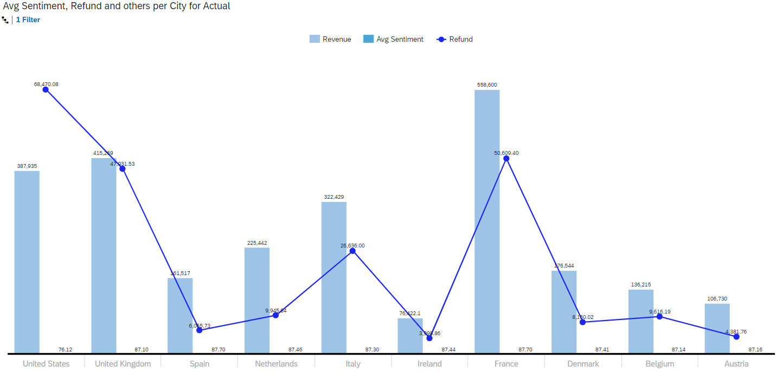
















OVERVIEW
ISSUES
CAUSE
SUGGESTIONS
Average Sentiment
US
UK
FRANCE
NETHERLANDS

Slide 20
Likely Cause of the Issues
OVERVIEW
ISSUES
CAUSE
SUGGESTIONS
Avg
Sentiment

Slide 21
OVERVIEW
ISSUES
CAUSE
SUGGESTIONS
FOR US

Slide 22
Suggestions
OVERVIEW
ISSUES
CAUSE
SUGGESTIONS

Slide 23
OVERVIEW
ISSUES
CAUSE
SUGGESTIONS
Investigate a potential quality issue in San Diego
Contact affected customers and interview (offer prize)
Test the full order cycle with secret customers.
Investigate potential counterfeit products in Los Angeles and Las Vegas
Look for Origin Data
Perform a competition research
Ensure fantom customers don’t have the ability to leave bad reviews without actual
verifiable purchase.
Upgrade your SAP SAC Account

Slide 24

Thank you.
Contact information:
Aditya Dey
SAP Support Engineer
Sambalpur, Odisha, India
78XXXXXXXX

